Slide 1
EFFICIENCY IDENTIFICATION OF DEEP LEARNING ALGORITHMS USING FUNDUS IMAGE FOR DIABETIC RETINOPATHY
by,
Arunkumaar t s
MENTOR: Ms SANGEETHA PRIYA Aswin s
Anitha Lakshmi s
Akshya a n

Slide 2
CONTENTS
Abstract
objective
Proposed system
ARCHITECTURE DIAGRAM
MODULE DETAILS
references
CONCLUSION

Slide 3
ABSTRACT
A diabetes disease that impacts the eyes is called diabetic retinopathy. Damage to the retina's blood vessels is what develops it, and if it is not treated, it can cause vision loss
This abstract provides an overview of diabetic retinopathy, including its causes, symptoms, diagnosis, and treatment options.
In this research paper, we associate the VGG-16 algorithm with our Xception CNN Model to deliver accurate results of different Algorithms

Slide 4
OBJECTIVE
This project aims to discover the best model and efficiency identification for the detection of diabetic retinopathy, which can help doctors decide the nature of the disease based on the symptoms using image analysis.
Our Primary OBJECTIVE IS TO DEVELOP A CLASSIFICATION METHOD USING IMAGE ANALYSIS WITH DEEP LEARNING Technology

Slide 5

PROPOSED SYSTEM
The goal is to identify diabetic retinopathy from the fundus image dataset as soon as possible, allowing individuals to proceed with the necessary treatments and avoid temporary or permanent vision loss
We will create deep learning models with DIFFERENT ALGORITHMS to detect DR and protect people at risk of losing their vision because there is no complete cure for this form of the disease.

Slide 6
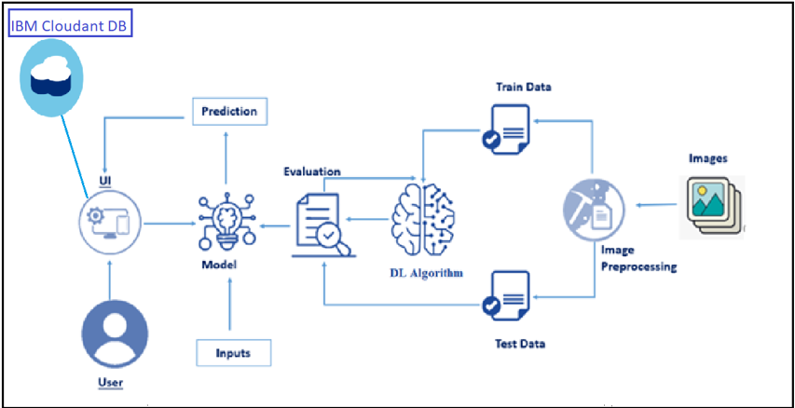

ARCHITECTURE DIAGRAM

Slide 7
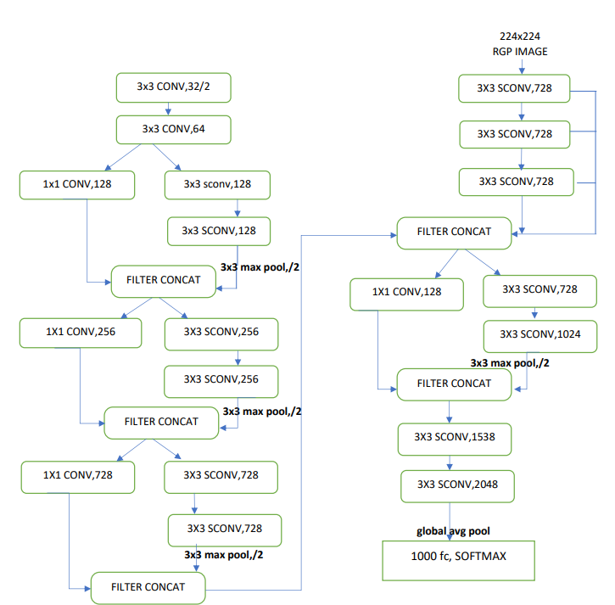
The Xception architecture consists of a series of convolutional layers that are organized into blocks.
Each block contains a number of depthwise separable convolutional layers, which are designed to perform spatial convolutions and channel-wise convolutions separately.

Slide 8
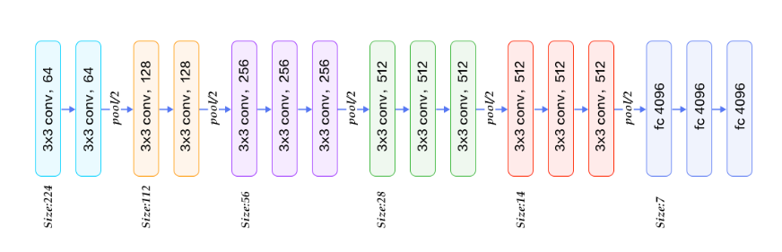
VGG16 contains 16 layers. A series of VGGs are exactly the same in the last three fully connected layers. The overall structure includes 5 sets of convolutional layers, followed by a MaxPool
In VGGNet, each convolution layer contains 2 to 4 convolution operations. The most obvious improvement of VGGNet is to reduce the size of the convolution kernel and increase the number of convolution layers.

Slide 9

MODULE DETAILS
DL Model
module 1:XCEPTION CNN
MODULE 2:VGG -16
MODULE 3:Performance Analysis
MODULE 4:FLASK APPLICATION BUILDING

Slide 10
DEEP LEARNING MODEL
In this project, we build an effective diabetic retinopathy classification method using a convolutional neural network (CNN). We classify DR into five categories, one normal and the other four different stages of dr using deep two-dimensional. We are creating a web application where the user selects the image which is to be classified. The image is fed into the model that is trained and the cited class will be displayed on the webpage.

Slide 11
MODULE 1: XCEPTION CNN
The Xception architecture is based on the Inception architecture, which is known for its use of multiple parallel convolutional layers with different filter sizes to capture features of different scales.
the Xception CNN obtained a top-1 accuracy of 75% and a loss of 1.9351%

Slide 12
MODULE 2: VGG-16
The VGG-16 architecture consists of 16 layers, including 13 convolutional layers and 3 fully connected layers. Its success is due in part to its simplicity and the fact that it uses small convolutional filters, which help to capture more local features in the input image.
The VGG-16 achieved a top-1 accuracy of 90.9% and a loss of 10.2262

Slide 13
MODULE 3:PERFORMANCE ANALYSIS
The results of our experiments showed that VGG-16 outperforms Exception CNNs in terms of top-1 accuracy and top-5 accuracy.
Algorithms | Accuracy | Loss
Xception CNN | 0.7500 | 1.9351
Vgg16 | 0.9096 | 0.2262

Slide 14
MODULE 4: FLASK
Python Flask is a popular web framework that allows developers to build web applications in a flexible and efficient manner.
we use the Flask development server to run our flask application. The development server automatically reloads our application when it is in testing and debugging mode.
We have created separate pages to analyse and predict using Deep Learning Algorithms Such as Xception Cnn and vgg- 16.
This website Clearly Projects the Efficiency Identification Between Two renowned algorithms that include Accuracy, features, and graphical representation of models trained.

Slide 15
REFERENCES
GULSHAN V, PENG L, CORAM M, ET AL. DEVELOPMENT AND VALIDATION OF A DEEP LEARNING ALGORITHM FOR THE DETECTION OF DIABETIC RETINOPATHY IN RETINAL FUNDUS PHOTOGRAPHS. JAMA. 2016;316(22):2402-2410. DOI:10.1001/JAMA.2016.17216.
ABRÀMOFF MD, LOU Y, ERGINAY A, ET AL. IMPROVED AUTOMATED DETECTION OF DIABETIC RETINOPATHY ON A PUBLICLY AVAILABLE DATASET THROUGH INTEGRATION OF DEEP LEARNING. INVEST OPHTHALMOL VIS SCI. 2016;57(13):5200-5206. DOI:10.1167/IOVS.16-19964.
RAJU M, PAGIDIMARRI V, BARRETO R, ET AL. DEEP LEARNING FOR AUTOMATED DETECTION OF DIABETIC RETINOPATHY USING SMARTPHONE-BASED RETINAL PHOTOGRAPHY. JAMA OPHTHALMOL. 2019;137(8):890-896. DOI:10.1001/JAMAOPHTHALMOL.2019.1758.

Slide 16
CONCLUSION
DR is often asymptomatic in its early stages, making it difficult to detect. Deep learning (DL) is a type of artificial intelligence that can be used to automatically detect patterns in data.
In this study DIFFERENT DL algorithmS were used to automatically detect DR in fundus images. The algorithmS wERE able to accurately detect DR in the early stages before it is symptomatic.

Slide 17
THANK YOU

